Slide 1
Conceptual Physics Fundamentals
Chapter 1:
ABOUT SCIENCE

Slide 2
This lecture will help you understand:
Science
Mathematics—The Language of Science
Scientific Measurements
Scientific Methods
The Scientific Attitude
Science, Art, and Religion
Science and Technology
Physics—The Basic Science

Slide 3
About Science
“I often say that when you can measure something and express it in numbers, you know something about it. When you cannot measure it, when you cannot express it in numbers, your knowledge is of a meager and unsatisfactory kind. It may be the beginning of knowledge, but you have scarcely in your thoughts advanced to the stage of science, whatever it may be.”
—Lord Kelvin

Slide 4
Science
Science
is a body of knowledge
is an ongoing human activity
has beginnings that precede recorded history
Science is the body of knowledge that describes the order within nature, and the causes of that order.

Slide 5
Mathematics—The Language of Science
Integration of science and mathematics
occurred some four centuries ago
ideas of science are unambiguous when expressed in mathematical terms
equations of science provide expressions of relationships between concepts
equations are “guides to thinking”

Slide 6
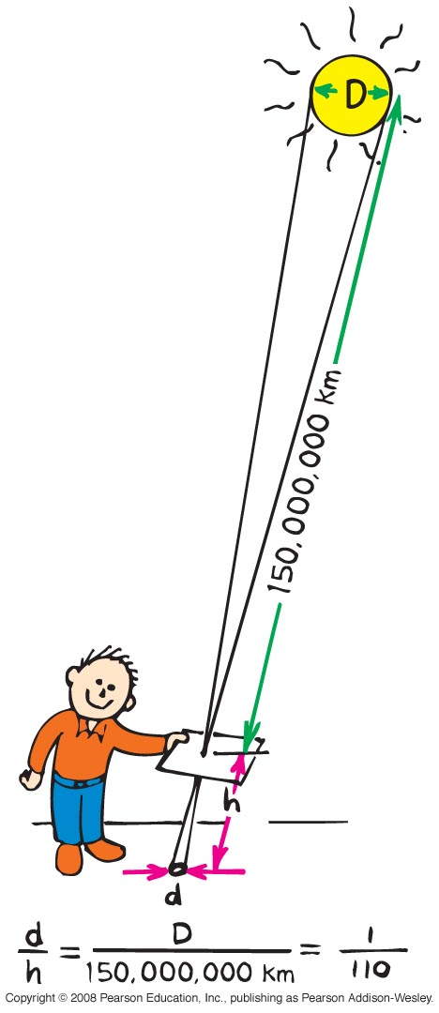
Scientific Measurements
Measurements
relate to how much you know
about something
of pinhole images of the Sun
nicely lead to a calculation
of the Sun’s diameter

Slide 7
Scientific Measurements
Measurement is foundation of the scientific method.
If its not measurable it isn't science.
How much you know about something is often related to how well you can measure it.
Making careful quantitative measurements are important.
The measurement accuracy is also fundamental to the to the scientific method.

Slide 8
Scientific Measurements
In 3rd century, scientists made fairly accurate measurements of the size of earth, moon and sun, as well as distances between them.
How did they do that without computers and calculators?
Trigonometry !!!

Slide 9
The size of Earth
First measured by Eratosthenes about 235 BC.
He learned: the Sun is highest in the sky at noon
On June 22, and it is directly overhead the city
Syene.

Slide 10
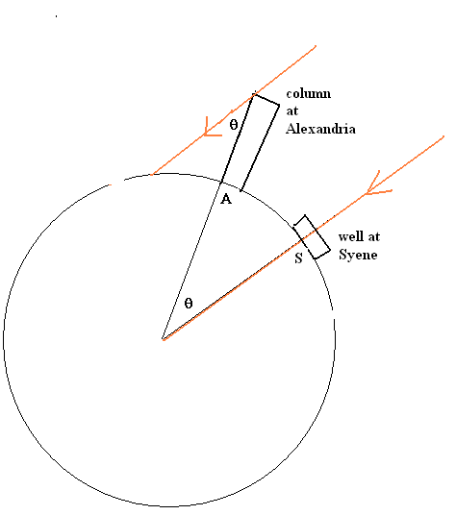
Measure the height (h) of the column
Measure the length (L) of the shadow
Solve for the angle (θ) using trigonometry
Angle θ = 7.2⁰
The distance between two cities = 800 km
If θ = 7.2⁰ makes 800 km arc, how much is the distance for 360⁰ angle?
Once the circumference (c) is known, the radius r = c/2π
Circumference of the earth = 40,000 km

Slide 11
How accurate do you think the angle and distance measurements were?
An uncertainty of 0.1 degree would be an accuracy of 0.1/7.2 or about 14%.
The circumference is 40,075 km at the equator and 40,008 km around the poles.
So, the accuracy is 0.02% to 0.2% !!!

Slide 12
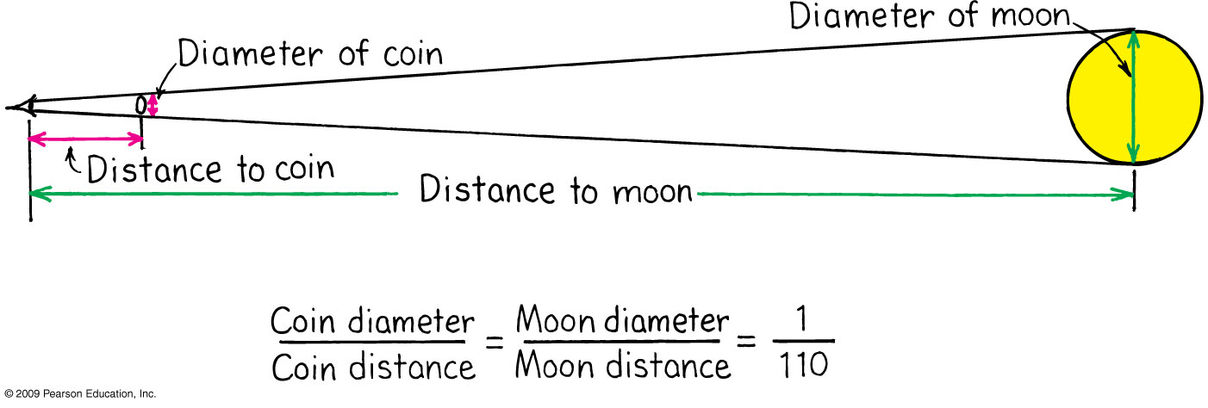
Distance to the Moon
With Aristarchus’s measurement of the Moon’s
diameter (see page 6), we can calculate the
distance to the Moon.

Slide 13
Scientific Methods
Scientific Methods
There’s no one method in which scientists do their work.
Common steps of most methods:
  1. Observe (recognize a question)
  2. Question (Hypothesis)
  3. predict
  4. test predictions
  5. draw a conclusion

Slide 14

Scientific Measurements
These round images of the Sun are crescent shaped during a partial solar eclipse.

Slide 15
The Scientific Attitude
The scientific attitude is one of
inquiry
experimentation
willingness to admit error

Slide 16
The Scientific Attitude
Scientists
are experts at changing their minds
must accept experimental findings
  test for erroneous beliefs
  understand objections and positions of antagonists

Slide 17
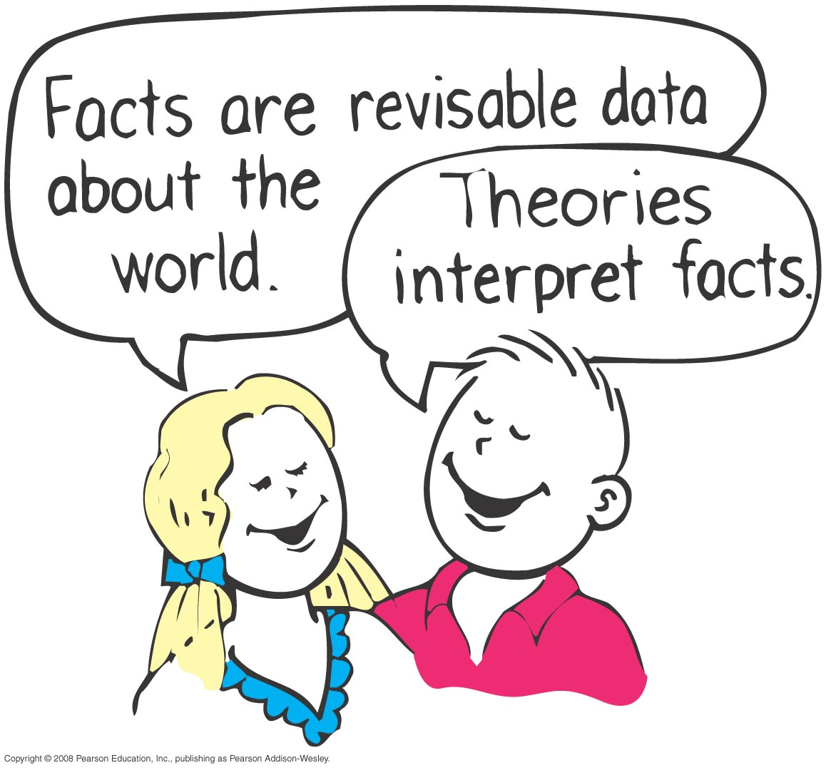
The Scientific Attitude
Fact
a close agreement by observers
about the same phenomenon
Hypothesis
an educated guess presumed to be factual until supported by experiment
Predicts facts and or other observations than can be measured.
scientific if there is a test to prove it wrong

Slide 18
Which of these is a scientific hypothesis?
The Scientific Attitude
CHECK YOUR NEIGHBOR
A. The Moon is made of green cheese.
Atomic nuclei are the smallest particles in nature.
A magnet will pick up a copper penny.
Cosmic rays cannot penetrate the thickness of your Conceptual Physics Fundamentals textbook.
Notes:
A., B., C., D.

Slide 19
Which of these is a scientific hypothesis?
The Scientific Attitude
CHECK YOUR ANSWER
A. The Moon is made of green cheese.
Atomic nuclei are the smallest particles in nature.
A magnet will pick up a copper penny.
Cosmic rays cannot penetrate the thickness of your Conceptual Physics Fundamentals textbook.
Explanation:
All are scientific hypotheses! All choices not only have tests for proving wrongness, but have been proved wrong. Nevertheless, they still pass the test of being a scientific hypothesis.
Notes:
A., B., C., D.

Slide 20
Which of these is not a scientific hypothesis?
The Scientific Attitude
CHECK YOUR NEIGHBOR
A. Protons carry an electric charge.
Undetectable particles are some of nature’s secrets.
Charged particles will bend when moving in a magnetic field.
All of the above are scientific hypotheses.
Notes:
B. Undetectable particles are some of nature’s secrets.

Slide 21
Which of these is not a scientific hypothesis?
The Scientific Attitude
CHECK YOUR ANSWER
A. Protons carry an electric charge.
Undetectable particles are some of nature’s secrets.
Charged particles will bend when moving in a magnetic field.
All of the above are scientific hypotheses.
Explanation:
If protons didn’t carry electric charge, they wouldn’t be deflected when crossing a magnetic field. This would be a test for showing the hypothesis wrong. So both A and C are capable of being proved wrong, which makes them scientific. Statement B, however, has no test for wrongness. It is reasonable speculation—but not a scientific hypothesis.
Notes:
B. Undetectable particles are some of nature’s secrets.

Slide 22
The Scientific Attitude
Theory
a synthesis of a large body of information that encompasses well-tested and verified hypotheses about certain aspects of the natural world
Examples: quark theory, theory of metallic bonding, cell theory, theory of evolution…
Law or principle
a theory that has been tested repeatedly and has not been contradicted
Useful for a large number of conditions, perditions or observations.

Slide 23
Which of these often changes over time with further study?
The Scientific Attitude
CHECK YOUR NEIGHBOR
A. Facts
Theories
Both of the above
Neither of the above
Notes:
C. Both of the above.

Slide 24
Which of these often changes over time with further study?
The Scientific Attitude
CHECK YOUR ANSWER
A. Facts
Theories
Both of the above
Neither of the above
Explanation:
Both can change. Is this a weakness or strength of science? For example, if everything a child holds true is unchanged when that child grows up, with years of study, even receiving advanced degrees, then either nothing was learned or the child was unusually gifted from the start—or was part of a closed system. As we learn new information, we refine our ideas. Likewise with the fields of science.
Notes:
C. Both of the above.

Slide 25
A person who says, “that’s only a theory” likely doesn’t know that a scientific theory is a
The Scientific Attitude
CHECK YOUR NEIGHBOR
A. guess.
number of facts.
hypothesis of sorts.
vast synthesis of well-tested hypotheses and facts.
Notes:
D. vast synthesis of well-tested hypotheses and facts.

Slide 26
A person who says, “that’s only a theory” likely doesn’t know that a scientific theory is a
The Scientific Attitude
CHECK YOUR ANSWER
A. guess.
number of facts.
hypothesis of sorts.
vast synthesis of well-tested hypotheses and facts.
Explanation:
Theory in everyday speech is vastly different than its use in science. A vast and verifiable body of knowledge isn’t only a theory; if it passes all its tests, it is elevated to that status! Newton’s theory of gravity and Einstein’s theory of relativity, for example, are not idle hypotheses—both are supported by innumerable experiments. They are more than only theories.
Notes:
D. vast synthesis of well-tested hypotheses and facts.

Slide 27
Science, Art, and Religion
Comparison of science, art, and religion by:
domain
  science is of natural order and in discovering and recording natural phenomena
  art is the interpretation and expression of human experience
  religion involves faith and worship of a supreme being

Slide 28
Science, Art, and Religion
similarities in art and in science
  knowledge of what is possible in human experience and in nature
  knowledge of both affects our views and decisions of the world
similarities in religion and in science
  both deal with unanswered questions

Slide 29
Between a pilot and a priest, who do you think should fly a commercial jet airplane? Who should perform a marriage? (Although the questions are no-brainers, they have a point.)
Science, Art, and Religion
CHECK YOUR NEIGHBOR
A. The pilot should fly the plane and the priest conduct a marriage.
The priest should fly the plane and the pilot conduct a marriage.
The pilot should conduct both.
The priest should conduct both.
Notes:
A. The pilot should fly the plane and the priest conduct a marriage.

Slide 30
Between a pilot and a priest, who do you think should fly a commercial jet airplane? Who should perform a marriage? (Although the questions are no-brainers, they have a point.)
Science, Art, and Religion
CHECK YOUR ANSWER
A. The pilot should fly the plane and the priest conduct a marriage.
The priest should fly the plane and the pilot conduct a marriage.
The pilot should conduct both.
The priest should conduct both.
Explanation:
The point of the questions is that the pilot and priest have nurtured different skills for different tasks, and each can do their thing well. Okay, one could argue that a pilot could adequately do both. But it would be a stretch to say a priest could do both, unless the priest also had training as a pilot.
Notes:
A. The pilot should fly the plane and the priest conduct a marriage.

Slide 31
Science and Technology
Science is concerned with gathering and organizing knowledge.
Technology is the use of scientific knowledge for practical purposes and to provide tools for further exploration.

Slide 32
Physics—The Basic Science
Physical sciences include geology, astronomy, chemistry, and physics.
Life sciences include biology, zoology, and botany.
Physics underlies all the sciences.

Slide 33
Although physics may be the most difficult science course in certain schools, when compared with the fields of chemistry, biology, geology, and astronomy, it is
Physics—The Basic Science
CHECK YOUR NEIGHBOR
A. the simplest.
still the hardest!
the central science, in between chemistry and biology.
simple enough, but only for especially intelligent people.
Notes:
A. the simplest.

Slide 34
Although physics may be the most difficult science course in certain schools, when compared with the fields of chemistry, biology, geology, and astronomy, it is
Physics—The Basic Science
CHECK YOUR ANSWER
A. the simplest.
still the hardest!
the central science, in between chemistry and biology.
simple enough, but only for especially intelligent people.
Explanation:
Just compare the list of terms in the physics chapters of this book with the lists in chapters of other textbooks. Which lists are shortest? Chemistry, and especially biology, are enormously more complex than physics. Physics is much more understood than the other fields—which is why this book begins with physics—a foundation for chemistry, biology, geology, and astronomy.
Notes:
A. the simplest.

